Slide 1
From Datacenter to Wide Area: Scale-Across
Federated Learning on Real Long-Haul RDMA
The 33rd IEEE Hot Interconnects Symposium (HOTI ‘26)
Zhonghao Chen, Yuke Li, Xiaoyi Lu
{zh.chen, xiaoyilu}@ufl.edu, yli304@ucmerced.edu
Parallel and Distributed Systems Laboratory (PADSYS Lab)
Department of Electrical & Computer Engineering (ECE)
University of Florida (UF)
Notes:
Good afternoon, everyone. Today I’m honoured to present our work
From Datacenter to Wide Area: Scale-Across Federated Learning on Real Long-Haul RDMA
I’m Zhonghao Chen, a second-year PhD student advised by Dr. Xiaoyi Lu.
<HOTI presentation>

Slide 2
Outline
Background and Motivation
Bottleneck Analysis
System Co-Design
Evaluation
Conclusion and Acknowledgments
“Long-haul RDMA can accelerate FL, but only with transport co-designed with the FL algorithms.”
Notes:
Quick overview of my talk:
I’ll start with some background and motivation. Then the analysis of the bottleneck in using long-haul RDMA in the federated learning setting. Then our design of LHR, a long-haul-friendly transport, the evaluation on real ESnet testbed, and the conclusion.
One sentence to hold onto for the whole talk: long-haul RDMA can accelerate federated learning, but it is not plug-and-play. The transport has to be co-designed with FL algorithms.
<Problem statement instead of why not RC in UCX: 1. how to fix 2. how to adapt RDMA to FL>

Slide 3
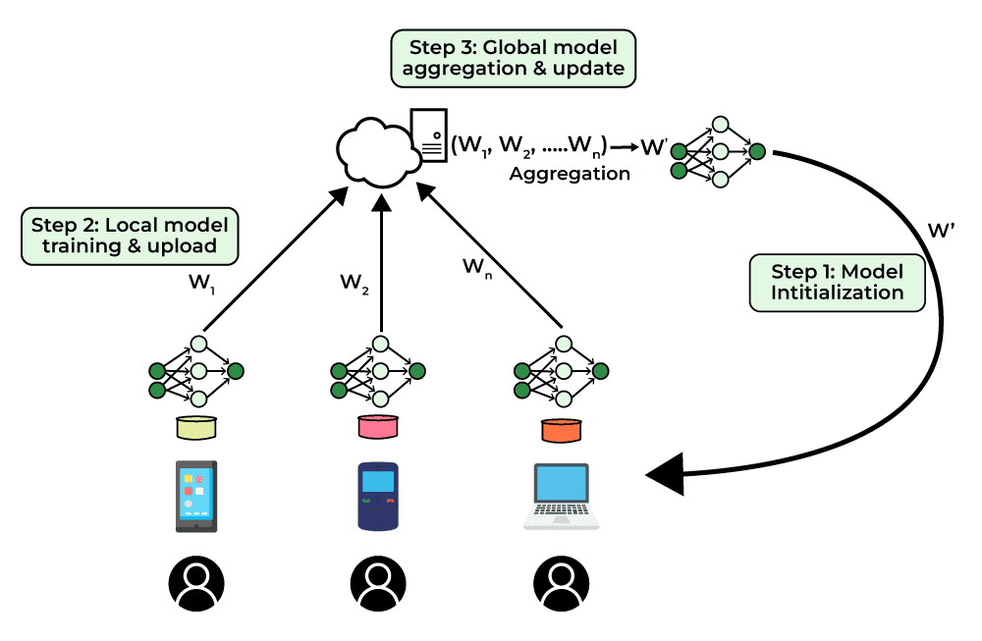
Federated Learning Introduction
Federated Learning (FL) enables private collaborative training
  Clients train locally and send model updates to a central server.
  The server aggregates client updates into a new global model.
  Scaling law: The larger of the scale (#Clients, model, etc.), the better.
The scaling problem within the FL paradigm
  Clients from geographically distant sites
  Larger models raising communication challenges
  FL becomes a wide-area communication
  problem.
Notes:
Federated learning, or FL, enables multiple clients to collaboratively train a model without sharing any private data, and it has been widely adopted for sensitive AI applications. (transition) Typically, we have a central server that is responsible for model distribution, collection, and aggregation, where clients, from smartphones to HPC clusters, conduct training locally using local data. By the scaling law, the larger the FL scale is, the better the model performance we will have. This includes the number of participating clients and the size of the model they train.
(transition) As federated learning has scaled up, the participants have spread out. Cross-silo deployments run between institutions and sites thousands of kilometers apart. That brings elevated latency, variable bandwidth, and stragglers driven by the network rather than by the computing hardware. And the consequence is the model must moves every round for every client in both directions crossing a continent, making FL a wide-area communication problem.

Slide 4
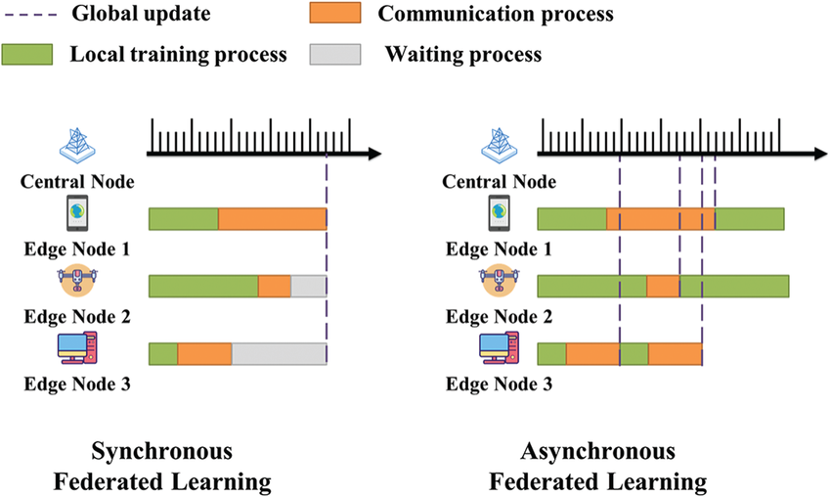
FL Algorithms
Synchronous algorithm
  Strict barrier before aggregation
  Ensure consistency, suffer from stragglers
Asynchronous
  Aggregate whenever the client returns
  Suffer from stale update
Semi-asynchronous
  Partial synchronization
  Group by metrics
  (model similarity, training speed)
Group
Semi-Asynchronous Federated Learning
Notes:
In general, FL can be categorized by the aggregation synchrony into three sets of algorithms. These algorithms differ mainly in when the server aggregates updates and how it handles slow or unreliable clients. Synchronous FL requires all selected clients to finish training before aggregation. This ensures consistency but suffers significantly from stragglers and unstable networks.
Asynchronous FL, on the other hand, allows the server to update the global model whenever a client returns its result, which greatly alleviate straggler effect but may introduce stale updates and hurt convergence.
Sitting in between, semi-asynchronous FL enforces partial synchronization, only waiting for a subset of clients or operating within a bounded delay. For example, FedBuff algorithm groups client updates by their relative computing speed and does separate aggregation. These three classes reveal that different FL systems may favor different synchrony designs.

Slide 5
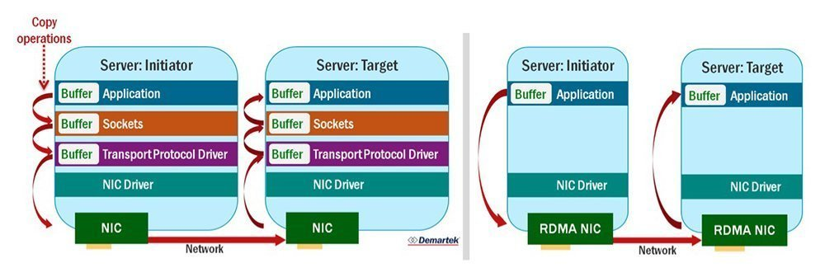
Motivation
Communication Domination
  A100 cluster, 1,024 clients
  Ceiling set by the TCP transport beneath them
  Marginal gains from optimizing computing
RDMA as an obvious substrate
  Zero-copy, kernel bypass
  Underexplored at wide-area network
  Long-haul RDMA
Notes:
Our work is motivated by the massive communication cost of federated learning in wide-area networks. (transition) The cost of that movement is shown here. These proportions are drawn from traces of a production federated learning deployment on A100 clusters with TCP/IP as network path, and the blue band is communication. On the server the share lies between 93 and 97 percent; the server performs almost no computation and is essentially a data mover. On the client, where genuine GPU training takes place, communication still accounts for 75 to 90 percent of wall time. Yet conventional established communication-efficient techniques like compression, sparsification, or pruning all operate on reducing or rescheduling the payload. None of them alters the transport beneath.
(transition) Therefore, if communication dominates, RDMA with zero-copy transfers, kernel bypass, no per-packet CPU involvement is the natural substrate to consider. This leads us to explore RDMA in a long-haul setting.

Slide 6
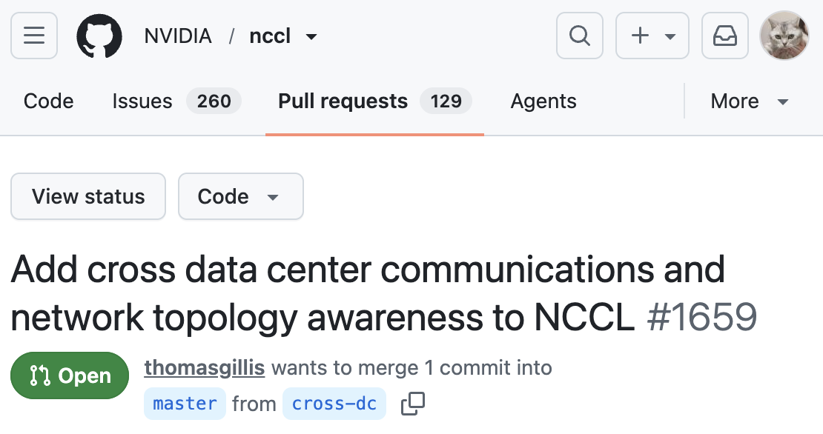
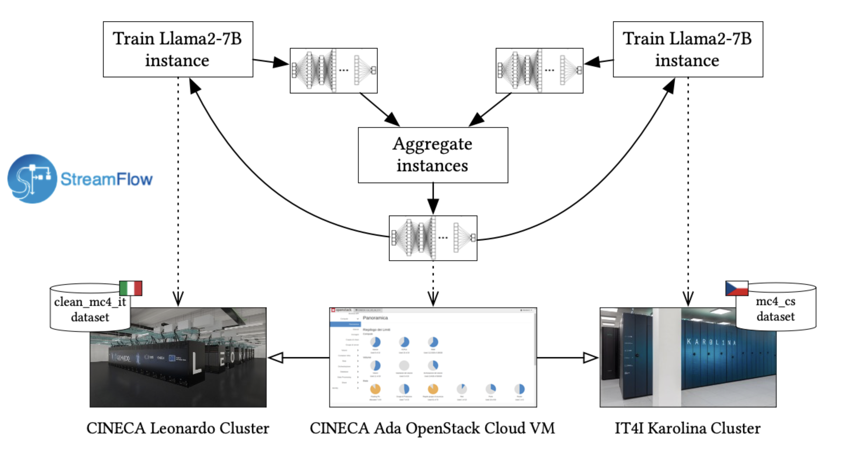
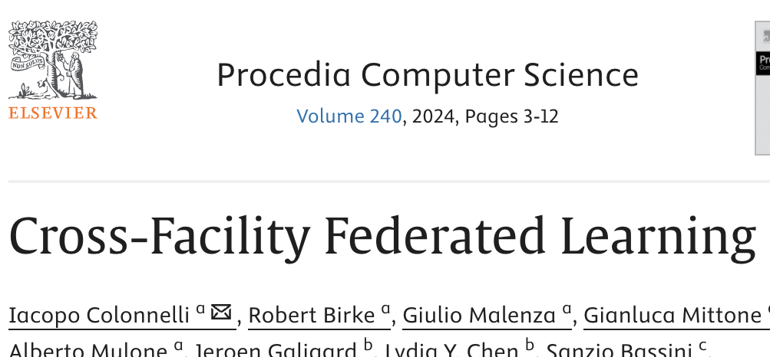

Why Long-Haul RDMA?​
Large training systems are already expanding across clusters and datacenters:
"At Gemini Ultra scale, we combine SuperPods in multiple datacenters using Google’s intra-cluster and inter-cluster network" -- Gemini Team, Google
"We had to scale to more compute and that compute was not available as part of one cluster. We had to go to multi-cluster training" -- Pre-Training GPT-4.5, OpenAI
Notes:
The premise of altering the transport here is not speculative. Large-scale training has already outgrown a single datacenter, and the evidence arrives from different independent directions, including the Gemini team combining SuperPods across multiple datacenters, NCCL now carring open pull requests adding cross-datacenter communication and network topology awareness, and cross-facility federated learning being already running across national HPC centres. Federated learning is therefore not an exotic case for long-haul interconnects. It is the case that arrives first, because its participants are administratively separate by construction.

Slide 7
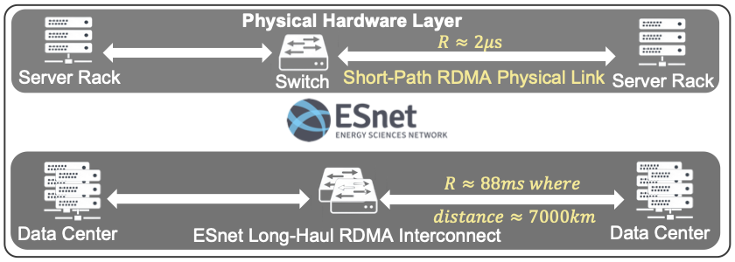
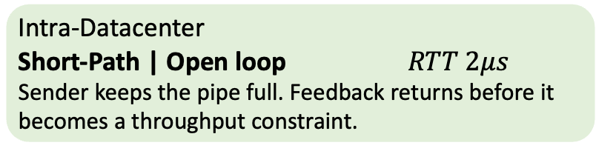
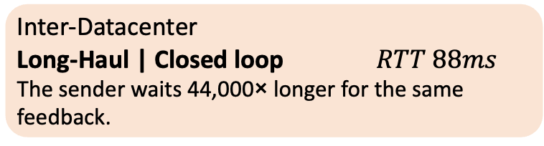
What Signifies in Long-Haul RDMA
The key change is Round-Trip Time (RTT)
Intra-Datacenter
Short-Path | Open loop $RTT 2μs$
Sender keeps the pipe full. Feedback returns before it becomes a throughput constraint.
Inter-Datacenter
Long-Haul | Closed loop $RTT 88ms$
The sender waits 44,000× longer for the same feedback.
Existing RDMA models and intuition assume the open-loop regime. Long-haul breaks them. So what actually the performace will be once feedback costs order-of-magnitude higher?
Notes:
Structurally, RDMA verbs or hardware remain the same for both. Only one parameter sigmofies the difference: round-trip time, or RTT. Inside a datacenter it is on the order of two microseconds. Across our ESnet seven thousand kilometres path, it is eighty-eight milliseconds.
But that single parameter changes the regime, not merely the magnitude. At two microseconds the sender operates open-loop: it keeps the pipe full, and feedback returns long before it can constrain throughput. At eighty-eight milliseconds the same system becomes closed-loop. The sender waits forty-four thousand times longer for identical feedback, and that wait now sits on the critical path. This matters because our models and our intuition for RDMA were developed entirely within the open-loop regime. Long-haul invalidates them.

Slide 8
Research Questions
Gap between data center and long-haul RDMA
  Microsecond RTTs, lossless fabric, hardware-managed reliability.
Can long-haul RDMA enhance the efficiency of FL in WAN?
  Does RDMA outperform TCP?
    A direct, like-for-like comparison at the same MPI layer, on the same NIC.
  Under which conditions?
    Which FL algorithm, model sizes and client counts amplify or mask the difference.
  Does it need co-design?
    Whether the benefit requires changes to communication and system-level components.
Notes:
That brings us to the gap this work addresses. Every property RDMA relies on was specified for a machine room: microsecond round-trip times, a lossless fabric, and reliability managed in hardware. None of those assumptions survives a wide-area path, and their combined behaviour under a real workload had not been measured.
The question we ask, therefore, is whether long-haul RDMA can enhance the efficiency of federated learning in a wide-area network. We decompose it into three questions. Does RDMA outperform TCP at all, and if yes, under which conditions? Which federated learning algorithm or set of configurations amplifies the difference? And further, does it require co-design? That is, whether obtaining the benefit demands changes to the communication and system-level components, or whether the transport can simply be replaced.

Slide 9
Outline
Background and Motivation
Bottleneck Analysis
System Co-Design
Evaluation
Conclusion and Acknowledgments
Notes:
We now explore the bottleneck when we adopt long-haul RDMA for federated learning.

Slide 10
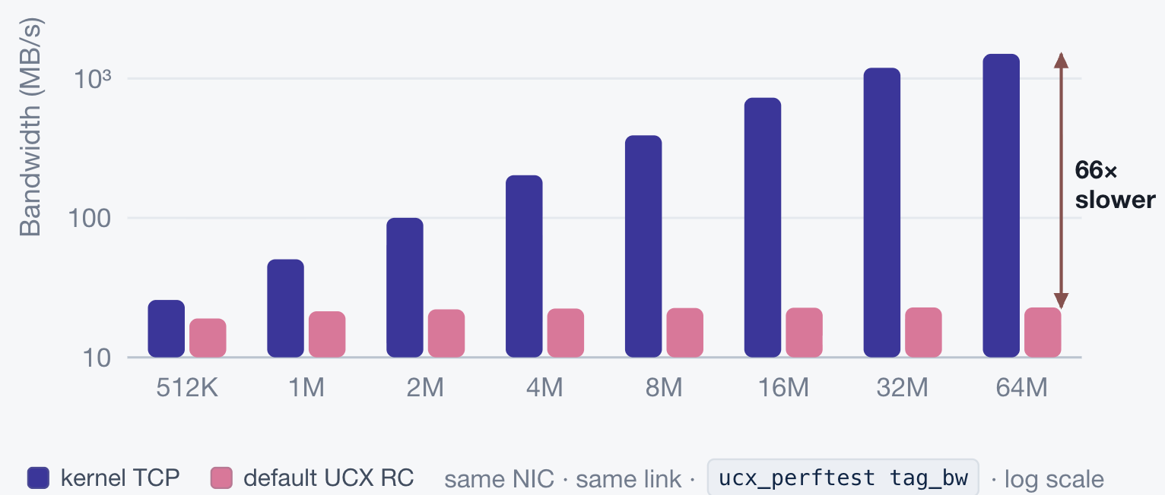
Default UCX RC at Long-Haul
Default UCX RC at long-haul RDMA envirounment
  Achieves only 23 MB/s per stream
  Independent of message size
  ib_write_bw reaches ~10.3 GB/s on the same link at 64 MB
The transport is emitting a fixed number of messages.
Notes:
The obvious first experiment is to place TCP and default RDMA side by side at the same layer, on the same NIC, and compare them directly.
The result is not what we anticipated. UCX-level TCP scales with message size in the ordinary way, reaching approximately 1.5 GB/s at 64 MB. Default reliable connection, over the identical link, plateaus at roughly 23 MB/s. It reaches that plateau already at 1 MB and does not improve at all through 64. At the largest message size, the RDMA path is 66 times slower than kernel TCP. The flatness is the diagnostic. A bandwidth limitation scales with message size, because larger messages amortize fixed per-message costs. A curve that does not respond to message size indicates something quite different: the transport is emitting a fixed number of messages per round trip, irrespective of what the application requested. End to end, this translates into federated learning runs that are up to19.5 times slower than TCP. Yet this is not a link problem, as indicated by a verbs-level measurement of 10 GB/s write bandwidth shown in the evaluations.

Slide 11
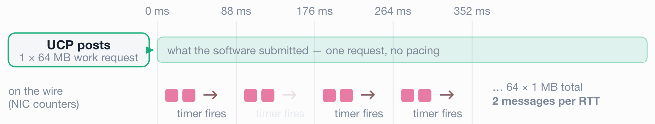
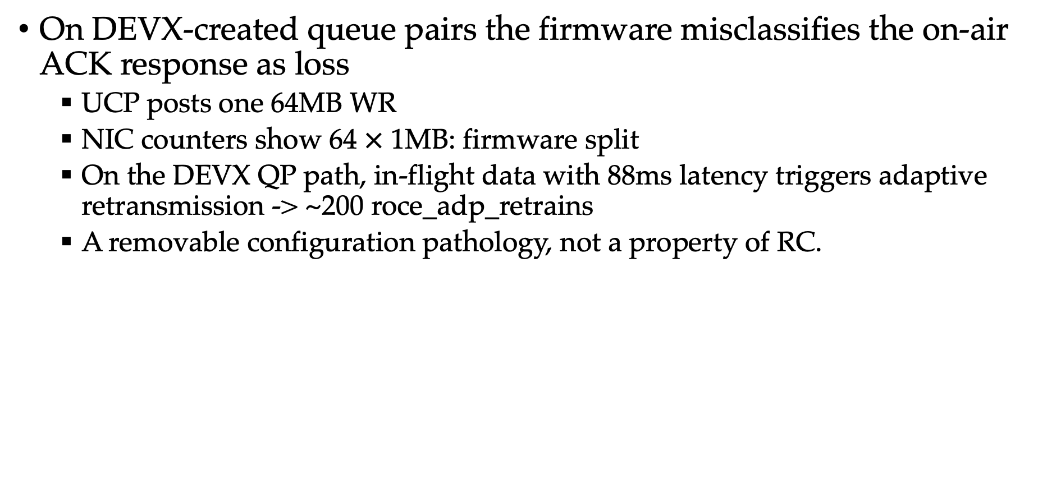
Root Cause: Firmware
On DEVX-created queue pairs the firmware misclassifies the on-air ACK response as loss
  UCP posts one 64MB WR
  NIC counters show 64 $×$ 1MB: firmware split
  On the DEVX QP path, in-flight data with 88ms latency triggers adaptive retransmission -> ~200 roce_adp_retrains
  A removable configuration pathology, not a property of RC.
Notes:
We therefore examined the NIC hardware counters. The application submits a 64 megabyte message to UCP, and UCP posts it as a single work request. The counters, however, record that same transfer arriving on the wire as 64 separate 1 MB requests, paced at two per round trip, accompanied by approximately 200 firmware retransmission events per 64 MB message. 2 MB every 88 ms is approximately 23 MB/s, which reproduces the observed plateau exactly. The flat curve was never a bandwidth limit; it was a retransmission timer.
The firmware's adaptive retransmission logic is provisioned for datacenter round-trip times. At 88 ms the acknowledgment is still in flight, yet the firmware classifies it as loss, and the transfer enters a slow restart. The behaviour is confined to queue pairs created through DEVX, which is UCX's default path. Queue pairs created through the legacy verbs interface do not exhibit it, which accounts for ib_write_bw performing correctly on the identical link.

Slide 12
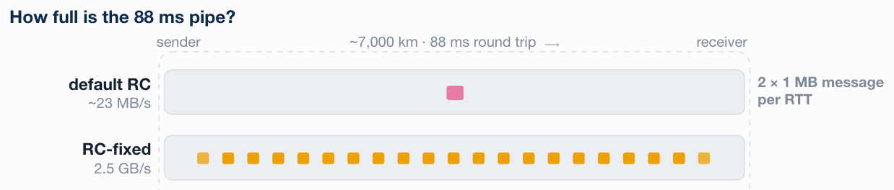
RC-Fixed
RC-Fixed
  Set UCX_IB_MLX5_DEVX=n
  UCX level improved to 4.3 GB/s; MPI level improved to 2.5 GB/s
  Change only the queue pair creation path
Notes:
Because the trigger is the queue-pair creation path, the correction is a single environment variable. Setting UCX_IB_MLX5_DEVX to n causes UCX to create its queue pairs through the standard verbs interface rather than through DEVX. No application code changes, and nothing else in the configuration changes. The retransmission storm disappears. At the UCX layer, 23 MB/s becomes 4.3 GB/s; at the MPI layer, 2.5 GB/s. That is two orders of magnitude recovered by one setting, and it is encouraged for anyone running RDMA over a wide-area link to verify this. This establishes that the catastrophic degradation is configuration-specific, intrinsic neither to reliable connection nor to long-haul RDMA. But observe the residue: even corrected, reliable connection reaches 4.3 GB/s against a wire capable of 10.3, which is less than half the fabric. That gap requires us to design the transport more efficiently, ideally with workload awareness.

Slide 13
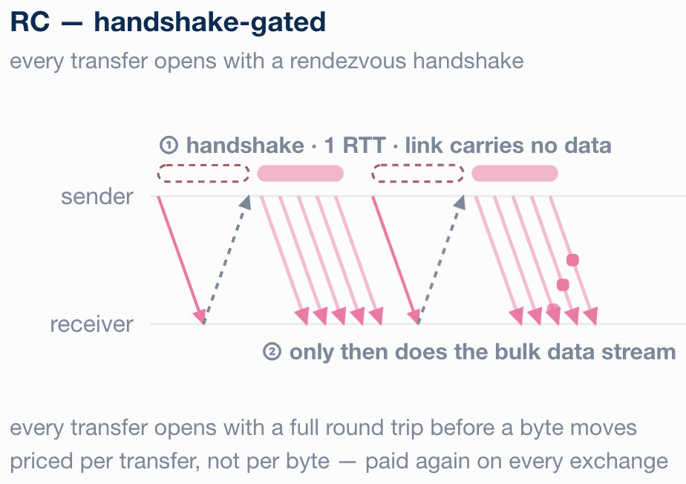

ACK-Coupled Completion
RC: ACK-coupled completion
  Send completion is still coupled to a wire-level ACK
  Hardware caps on in-flight requests remain
  Each transfer still pays a rendezvous
  handshake
The bottleneck is a property of the
default UCX RC transport
  A transport decouples payload transmission
  from ACK-dependent reliability control
  Workload (FL) awareness is missing.
  The default chain from the FL aggregator
  down to verbs assumes short-RTT
  behaviour at every level.
Notes:
Under RC, a large transfer does not begin with data. It begins with a rendezvous handshake: the sender issues a request, the receiver returns an acknowledgment, and only then does the payload stream. The opening exchange is a complete 88ms round trip during which the link carries nothing at all. Federated learning does precisely the opposite: FedAsync performs a down-and-up exchange on every client update, so that same fixed round trip is paid over and over. Two further costs follow. Send completion remains tied to a wire-level acknowledgment, so buffers are not released until a round trip after the data has gone. And recovery is go-back-N, which rolls back an entire window on a single loss, where the window spans 88 ms. None of this is configurable. This is a property of the transport, and removing it means designing a different one, with ACK off the critical path and with FL awareness.

Slide 14
Outline
Background and Motivation
Bottleneck Analysis
System Co-Design
Evaluation
Conclusion and Acknowledgments
Notes:
This brings us to the design.

Slide 15
Long-haul RDMA Co-design
LHR presents four layers of adaptation across the network
  Driven by constraints the neighbouring layer cannot absorb.
  Concentrate in the FL application layer and UCX transport
  MPI runtime is left unmodified.
  Choosing UC + UD/DC at RDMA verbs level
Notes:
As we discussed, the RC-fixed still presents bottleneck inherent to RC. We therefore presents our long-haul-friendly RDMA, or LHR, as shown in this diagram, with the complete stack of the federated learning aggregator, the MPI runtime, the UCX transport, and RDMA verbs. The principle we applied is that each adaptation is driven by a constraint the adjacent layer cannot absorb. These design mainly concentrate on the FL application layer and the UCX transport layer. At the FL layer we adopt chunking for model weights; at the MPI layer we use the stock MPICH runtime; at the UCX layer we present our LHR transport; at the RDMA verbs layer we choose UC +UD/DC for primitives.

Slide 16
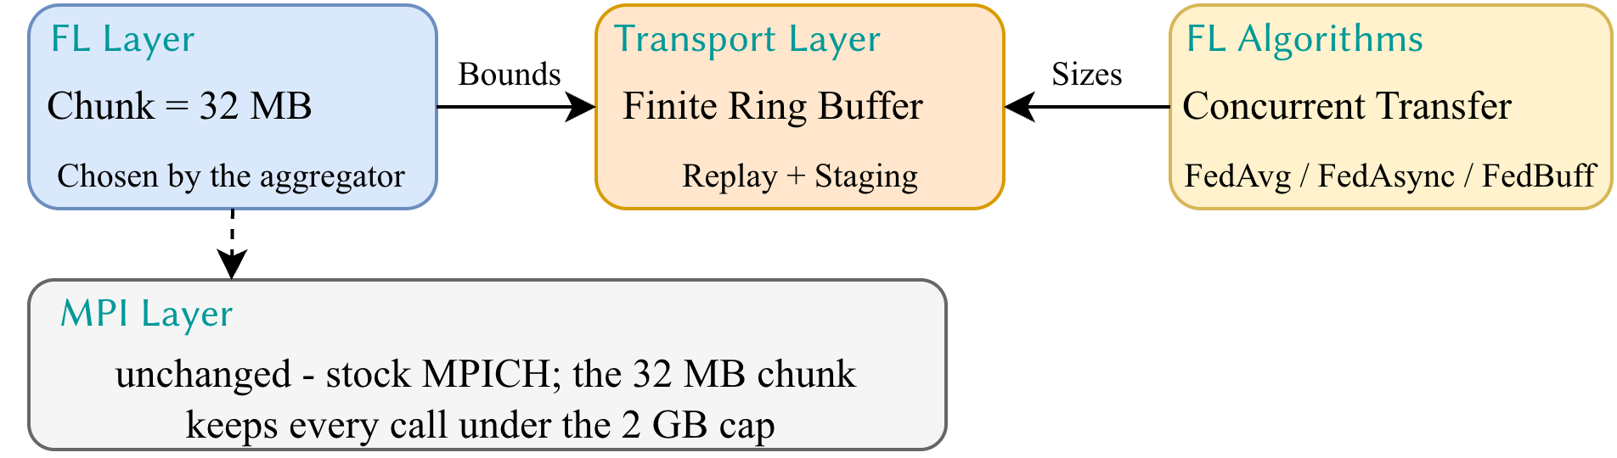
FL & MPI Layer
Foundation-model parameters reach GB or TB level
  A single MPI call is capped at ~2 GB with MPI_BYTE
Divide model tensors into 32 MB chunks
  Large enough to amortize MPI invocation overhead
  Small enough to bound sender-side replay buffering
  Enables efficient pipelined transmission
Notes:
The foundation model parameters nowadays reach the GB or TB level, yet a single MPI call is limited to roughly 2 GB. The design decision is where the chunking happens and what value is chosen. We chunk at the federated learning layer, because the aggregator is the only layer that knows both the tensor structure and the aggregation policy. And the value of 32 MB chunk is not selected in isolation. It is selected jointly with the transport's replay window. Had the aggregator handed MPI a single send even under the 2 GB limit, the transport would have to size its replay buffer for an entire model. Chunking 32 MB is precisely what permits a bounded ring buffer underneath.
The second decision is a deliberate non-change. We keep the MPI runtime stock. That is a constraint we imposed on ourselves so the result remains deployable, and the chunk size is what honours it: every call stays below the cap, so MPI never needs to learn that the path is long.
The payoff is that a single chunked stream serves all three policies. The policy alters only how often that stream is emitted, and that frequency is exactly the parameter the ring buffer beneath is tuned on.

Slide 17
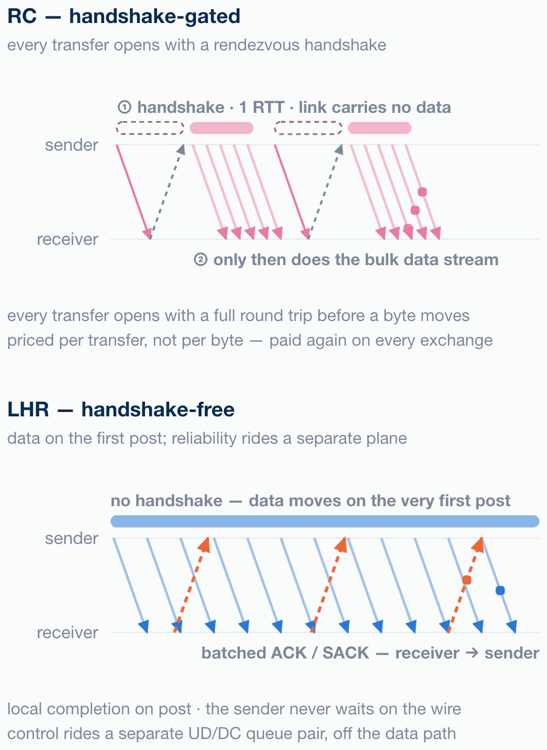
LHR vs. UCX RC Transport
Take reliability control off the critical path
Data plane
  Fixed-size fragments moved with
  UC RDMA write-with-immediate.
  The sender obtains local completion
  as soon as a fragment is posted
Control plane
  LHR rebuilds reliability in software
  ACK / SACK and retransmission traffic
  runs on a separate queue pair
Notes:
At UCX transport layer, we present the LHR design. The key idea here is to take reliability control off the critical path. On the top is the reliable connection. Each send completion is chained to an acknowledgment returning across 88 milliseconds. A packet departs, and the sender then waits, blocked for a full round trip before the next completion can occur. Accumulated across messages, the link remains largely idle. On the bottom is LHR. The sender copies a fragment into a transport-owned replay buffer, posts it as a UC RDMA write-with-immediate, and obtains local completion immediately. It does not wait on the receiver and therefore continues to transmit; bytes remain in flight continuously. However unreliable connection provides no delivery guarantee, and MPI requires one. LHR therefore reconstructs reliability in software, but conducts all acknowledgment and retransmission traffic on a separate UD or DC queue pair. The acknowledgment path simply no longer occupies the critical path.

Slide 18
FL Awareness
LHR adopts FL-algorithm-aware replay buffering and ACK batching
  Sender-side replay and receiver-side staging are bounded by a finite ring-buffer window
  The capacity is adaptively configured to the expected number of concurrent model transfers based on algorithms
Ring size and cumulative-ACK threshold are tuned jointly
  Buffer capacity sets how many replay slots exist
  ACK cadence sets how fast they are released
LHR registers as a standard UCT transport
  Selected through a UCX environment variable
Notes:
One further element is FL awareness. LHR bounds replay and staging with a finite ring-buffer window. The question is how large that window should be and how it should be partitioned. Our observation is that the aggregation policy, not the model, determines the answer. FedAvg produces a synchronized burst, with many uplinks arriving concurrently, so the ring is partitioned conservatively across clients to prevent any single stream from monopolizing it. FedBuff is treated similarly, sized from its buffer depth. FedAsync has the opposite character, where its transfers are arrival-driven, and each exchange lies directly on that client's critical path. There we favour a larger per-stream allocation and acknowledge more frequently, since prompt release of replay slots is what reduces turnaround time. Finally, LHR registers as a standard UCT transport, selected through a UCX environment variable. Nothing above UCX is recompiled.

Slide 19
Outline
Background and Motivation
Bottleneck Analysis
Co-Design
Evaluation
Conclusion and Acknowledgments
Notes:
I will now present the evaluation.

Slide 20

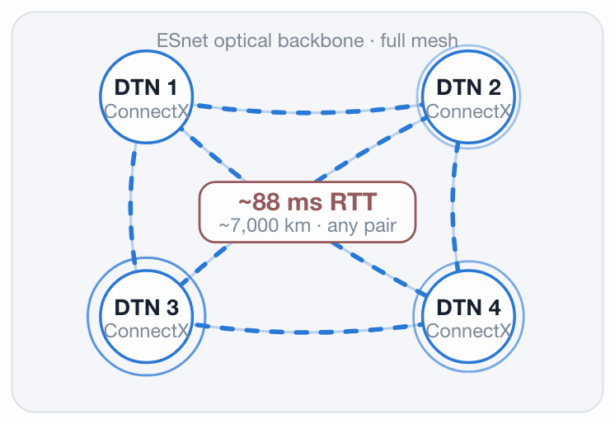
Evaluation Platform
Platform
  Energy Sciences Network (ESnet)
  Four data transfer nodes (DTNs),
  each with ~88ms latency
  Transport used: TCP; RC (default) and RC-fixed;
  LHR
Framework and workloads
  Real traced from APPFL v0.4.2 + proxy rebuild
  Vision transformer (ViT) and VGG-16
  FedAvg (sync), FedAsync (async), FedBuff (semi-async)
Notes:
To evaluate LHR, we conduct our evaluations upon the Energy Sciences Network, or ESnet, long-haul RDMA nework. We use four ESnet data transfer nodes, connected in a full mesh over its optical backbone, with a measured 88 ms round trip between any two. The network comparison is between RoCEv2 and kernel TCP share the same NIC on the same VLAN.
Four transports of LHR, RC default, RC fixed as we discussed, and TCP are compared. We use APPFL framework deployment as the real FL deployment traces and build a FL proxy. Vision transformer and VGG-16 are used as the target model for training, for three types of algorithms: FedAvg for synchronous, FedAsync for asynchronous, and FedBuff for semi-asynchronous.

Slide 21
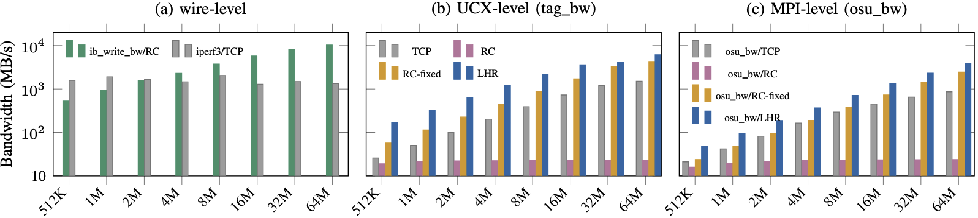
Microbenchmark
RDMA verbs level: the wire is fine
  Raw RDMA WRITE climbs 527 MB/s → 10.3 GB/s. TCP holds 1.3–2 GB/s.
The cliff appears at UCX level
  Default RC plateaus at 19 MB/s at 512 KB with no scaling through 64 MB. UCX-level TCP scales linearly to ~1.5 GB/s.
  RC-fixed scales to 4.3 GB/s; LHR scales to 6.0 GB/s.
Notes:
To localize the penalty we measured point-to-point bandwidth at three levels of abstraction on the same link. Both plots use a logarithmic scale.
Panel (a) is the control. Raw RDMA WRITE, with no middleware, rises from 527 MB/s to 10.3 GB/s. That curve is the bandwidth-delay product of an 88ms link. Kernel TCP holds between 1.3 and 2 gigabytes once its buffers saturate. After panel (a), the network can no longer be held responsible. Any degradation beyond this point originates in software.
Panel (b) is where the behaviour breaks. Default reliable connection plateaus at 19 MB/s and does not scale 64 MB. UCX-level TCP, on the same NIC, scales to approximately 1.5 GB/s. With our fixed DEVX, RC restores scalability and achieves 4.3 GB/s of bandwidth. With further ack decoupling, our LHR further achieves 6.0 GB/s.

Slide 22
Microbenchmark
MPI level
  LHR recovers two orders of magnitude
  The RC-fixed → LHR gap of 1.56–1.98× isolates LHR's own contribution
Notes:
Introducing MPI does not alter the reliable-connection result: the plateau persists unchanged at 23.8 MB/s, as the pathology originate from the UCX transport level. In comparison, LHR recovers two orders of magnitude relative to default reliable connection, a factor of 160 times at 64 MB, at a bandwidth of 3.8 GB/s. The majority of this factor is attributable to the configuration correction rather than to our transport. The comparison of RC-fixed and LHR isolates LHR's own contribution, and that factor lies between 1.56 and 1.98.

Slide 23
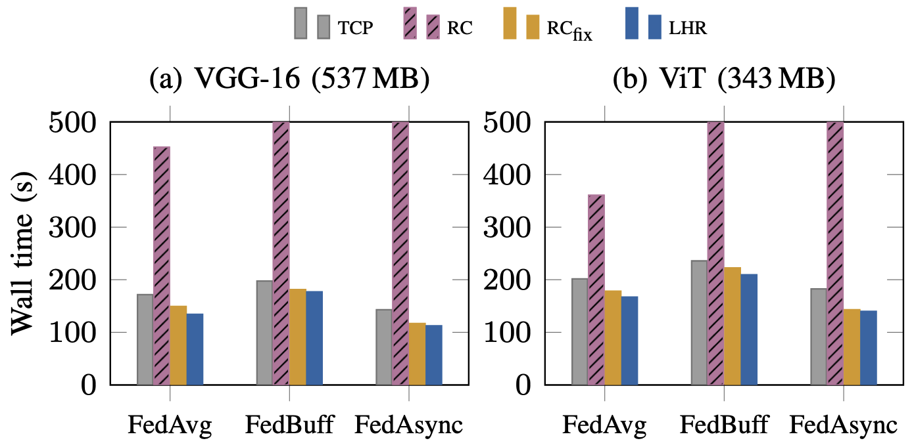
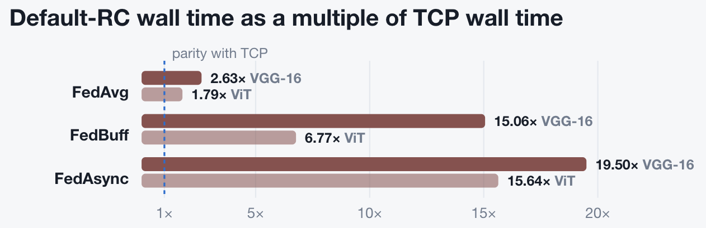
End-to-End FL Runtime
LHR is the most efficient transport in the long-haul FL setting.
  112–177 s across the three policies, substantially faster.
  Default RC massively exceeds on FedBuff and FedAsync, leaving it unusable as a default transport for asynchronous FL at this RTT.
  ViT reproduces the same result structure
Notes:
We then move on to the end-to-end FL runtime. Across three policies and four bars each, LHR in blue achieves the lowest in all three.
The notable column is the default RC. Under FedAvg, default reliable connection requires 452 seconds against TCP’s 172. Under FedBuff and FedAsync the runs did not complete within a 30 min budget. To anchor the scale: LHR completes FedAsync in 112 seconds. Default reliable connection, on identical hardware, is projected at 2790 seconds. Therefore the first observation is that LHR is the most efficient transport in this setting, bringing all three workloads substantially closer to the compute floor, while the default RC massively increase the FL runtime, making it unsuitable even compared to TCP.
ViT reproduces the same structure at reduced magnitude. With a smaller model, ViT incurs a smaller absolute penalty, the per-message penalty is therefore essentially constant. What varies is the number of times it is incurred. The FL algorithms that suffer most are precisely asynchronous algorithms, due to high frequency of communication invocation. Yet asynchrony is the standard response to stragglers and high latency especially at wide-area heterogenous computing settings. The default RC stack therefore penalizes exactly the correct design decision, while LHR presents the largest gain.

Slide 24
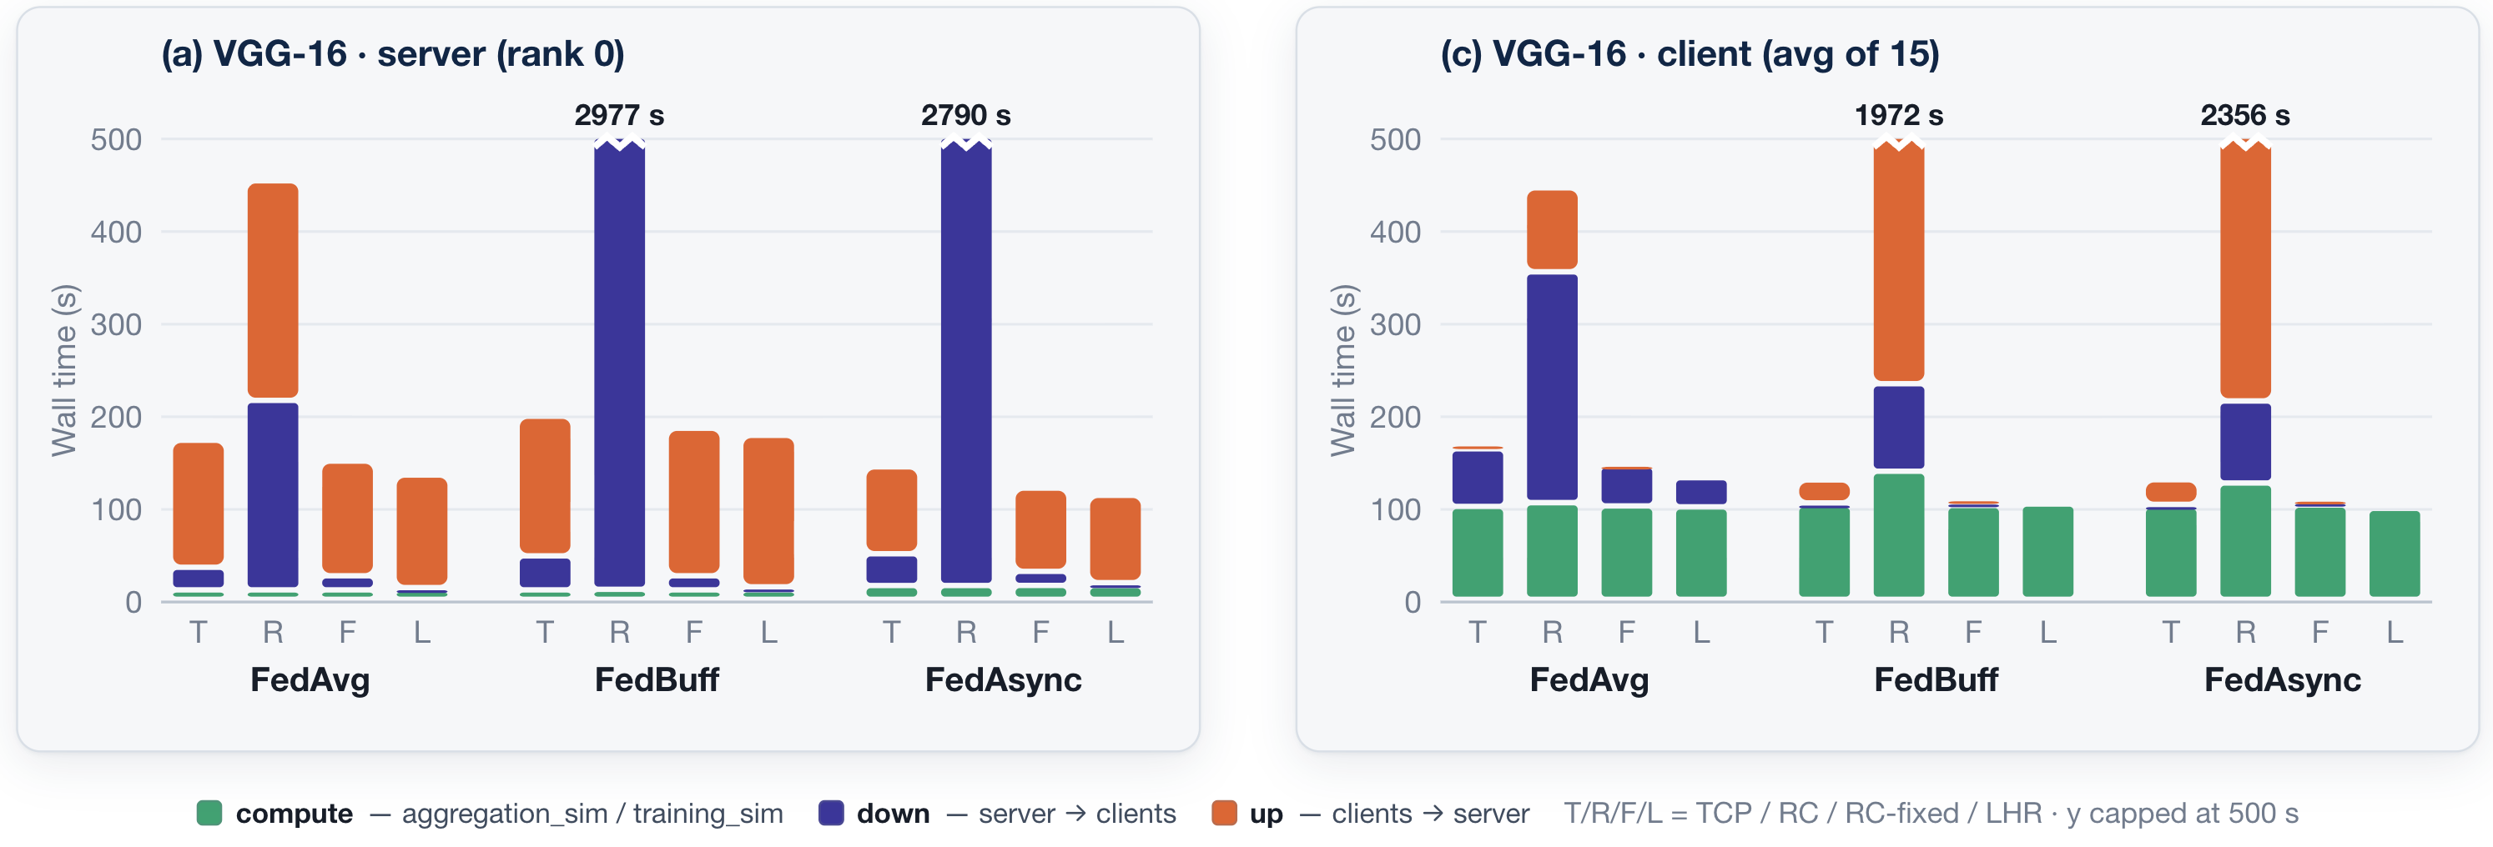
Runtime Breakdown
Compute is constant and small: can be under 11.5% of runtime
The RC penalty is symmetric for both down and up time
  RC is 82× LHR for down time, with 249s vs. 32s in up time
The observations are transferrable across models
Notes:
To localize where the wall time is spent, the proxy emits per-phase traces. The left panel is the server, the right is the fifteen-client average. Green denotes compute, violet the downlink from server to client, orange the uplink from client to server.
The compute time does not vary. It is essentially identical across all twenty-four cells. That is our control. The workload is genuinely constant, so every difference observed is attributable to the network. The band is also small, with computation accounting for under 11.5% of runtime.
Second, the reliable-connection penalty is symmetric. The server's downlink band under RC is 8.4 times the TCP value, and the client view reflects this from the receiving side: clients wait 249 seconds for a model that LHR delivers in 32. Symmetry of this kind is what a hardware pacing limit would produce, since such a limit has no directional preference.
Third, consider the orange band on the client panel for the FedBuff and FedAsync reliable-connection cases. That is where the order of magnitude resides: a FedAvg client transmits once per round, whereas a FedAsync client transmits on every arrival.

Slide 25
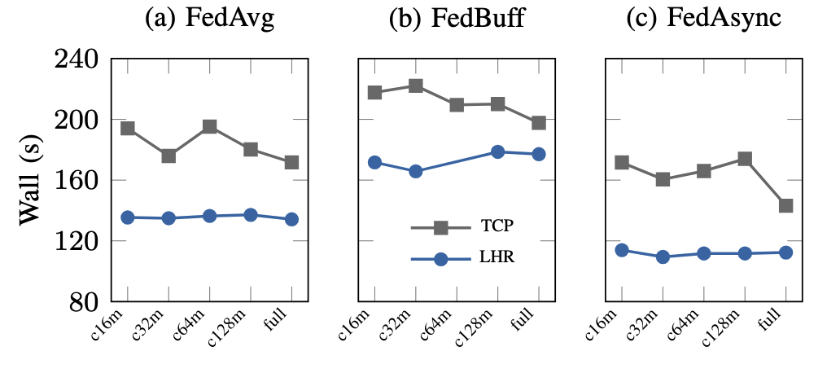
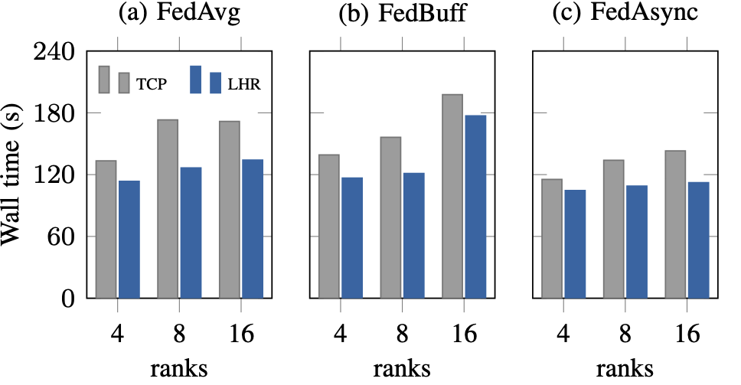
Sensitivity of Chunk and Scale
Chunking does not close the gap
  LHR sits below TCP by a constant margin
Sublinear scaling
  4 → 16 ranks adds +28.8% to TCP and +18.2% to LHR on FedAvg.
  The advantage holds at 1.10–1.37× at every scale.
Notes:
We then investigate the sensitivity of the LHR to FL chunking and client scale.
On the left is chunk size. If the long-haul penalty is driven by per-message size, smaller chunks would reduce wall time. Yet both curves are flat, and more importantly the separation between LHR and TCP is constant at every granularity. Application-level chunking and transport efficiency therefore address genuinely distinct bottlenecks. Since we observe gains from a 32 MB chunk, we adopt the configuration for our main evaluations.
On the right, client scale. Scaling from 4 to 16 ranks is sublinear for both transports, because communication overlaps client execution. FedAsync is the most favourable case, and the advantage of LHR over TCP is preserved at every scale measured, between 1.1 and 1.37 times, and the advantage dilates as the scale increases.

Slide 26
Outline
Background and Motivation
Bottleneck Analysis
System Co-Design
Evaluation
Conclusion and Acknowledgments

Slide 27
Summary
Problem
Federated learning increasingly turns into a wide-area communication problem. Whether long-haul RDMA can serve as the substrate has not been measured on real infrastructure.
Objective
Determine whether RDMA outperforms TCP for FL in the wide area, under which conditions the advantage is most significant.
Key Idea
Co-design transport layer with FL awareness and take ACK off the critical path.
Key Contributions
- LHR, a long-haul-friendly transport that outperforms TCP by up to 1.31× and default UCX RC by up to 24.84×, robust to chunk-size and client-count sweeps.
- Characterization of default UCX RC’s failure of DEVX-triggered firmware retransmission at long RTT.
- Evaluation of long-haul RDMA for FL on a real ~88 ms ESnet testbed, across three algorithms.
Future Work
Further optimize the design for performance and scalability.
Notes:
To wrap up, let me briefly revisit the core message of this work.
The problem we set out to address is the lack of measurement for RDMA as a substrate for wide-area federated learning deployments. Our objective, therefore, was to determine whether RDMA outperforms TCP for FL in the wide area, and under which conditions the advantage is most significant.The key idea behind is to co-design the transport layer with FL awareness and take ACK off the critical path. .
Based on this idea, our key contributions are threefold. First, we propose LHR, a long-haul-friendly transport that outperforms TCP and default UCX RC by up to 24×. Second, we conduct characterization of default UCX RC’s failure of DEVX-triggered firmware retransmission at long RTT. Third, we evaluate different transports on long-haul RDMA for FL on a real 88 ms ESnet testbed, across three algorithms.
In the future, we plan to enhance LHR design for better performance and scalability, and investigate the difference between verbs level bandwidth and the UCX level.

Slide 28



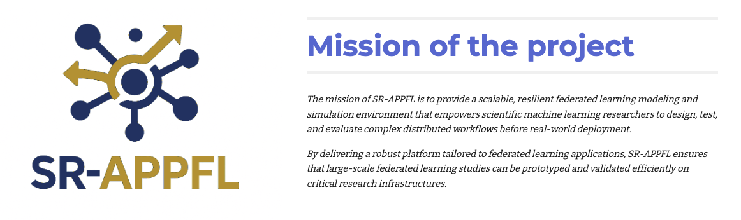
Acknowledgement
SR-APPFL
We thank all anonymous reviewers for their valuable feedback
We also appreciate the constructive discussions and support from our colleagues and collaborators
This work is under the SR-APPFL project
This work was partially supported by
- U.S. NSF research #2623546, #2623548, #2623610, and #2623611
- U.S. Department of Energy (DOE) under grant DE-SC0024207
- This research made use of the Energy Sciences Network (ESnet), the U.S. Department of Energy Office of Science’s high-performance networking user facility
Notes:
That’s all I have for today. We thank all the reviewers and our colleagues for their feedbacks. We also thank ESNet for providing the hardware and accompanying support for us to conduct this research. This work is under the SR-APPFL project, where we aim to build scalable and resilient advanced privacy-preserving federated learning systems and infrastructures. Please visit our website for more details. Thank you.

Slide 29


Thank you! zh.chen@ufl.edu http://padsys.org/

